Slide 1


Exposure CS 2020
for CS1
Chapter 3 Section 1-2 Slides
Introduction to Python Coding:
Using jGRASP
PowerPoint Presentation
created by:
Mr. John L. M. Schram
and Mr. Leon Schram
Authors of Exposure
Computer Science

Slide 2
Section 3.1
Introduction

Slide 3
Introduction
This chapter will start by showing you the necessary tools to write simple programs. Keep in mind that you will be creating your programs in a high-level language, Python. This means you need some type of editing environment in which to write your programs. After the program is written you need to translate and execute your program. For now, learning those fundamental program-writing skills is your primary concern.

Slide 4
Section 3.2
Using jGRASP
for Python

Slide 5


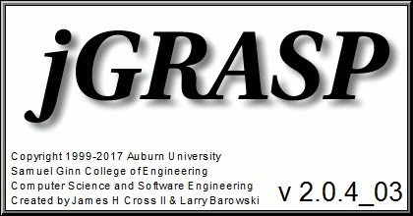
Required Software
In Chapter 2 you installed the Java, jGRASP and Python in order to write and execute Python programs. You may wonder why you had to install Java to run Python programs. The answer is jGRASP was written in Java and cannot execute without it.

Slide 6
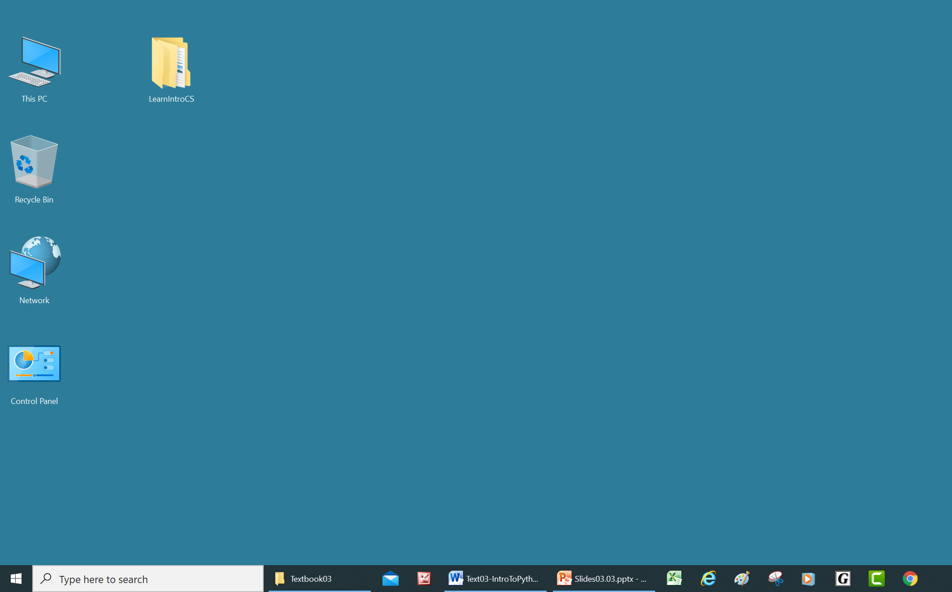
The LearnIntroCS Folder
This chapter assumes that the LearnIntroCS folder has been been copied to your Desktop.
If you have this folder in a different location, (Documents for example) then you will need to go to that location anytime the directions say to go to the Desktop. If you do not have this folder at all, you will need to get a copy of it from your teacher before you can do anything else.

Slide 7
What is an IDE?
IDE stands for Integrated Development Environment.
An IDE is an “environment” that contains everything you need to “develop” programs all “integrated” together.
Features of an IDE
Text Editor | A full screen editor for writing your programs
 | A file manager to save programs and load them again later
Translator | Used to translate your source code into machine code. Most languages use a compiler. Python uses an interpreter.
Output/Message Window | Show the output of your programs or displays error messages

Slide 8

jGRASP
The IDE that we will be using is jGRASP.
One of the main reasons that we are using jGRASP is that it is freeware.
jGRASP also has other features that make it work well for our lab lectures and lab assignments.
You will find the jGRASP icon either on
your Desktop, Start menu, Taskbar, Dock,
or amoung other apps in the Launcher.
Click/Double-click the icon to load jGRASP.

Slide 9
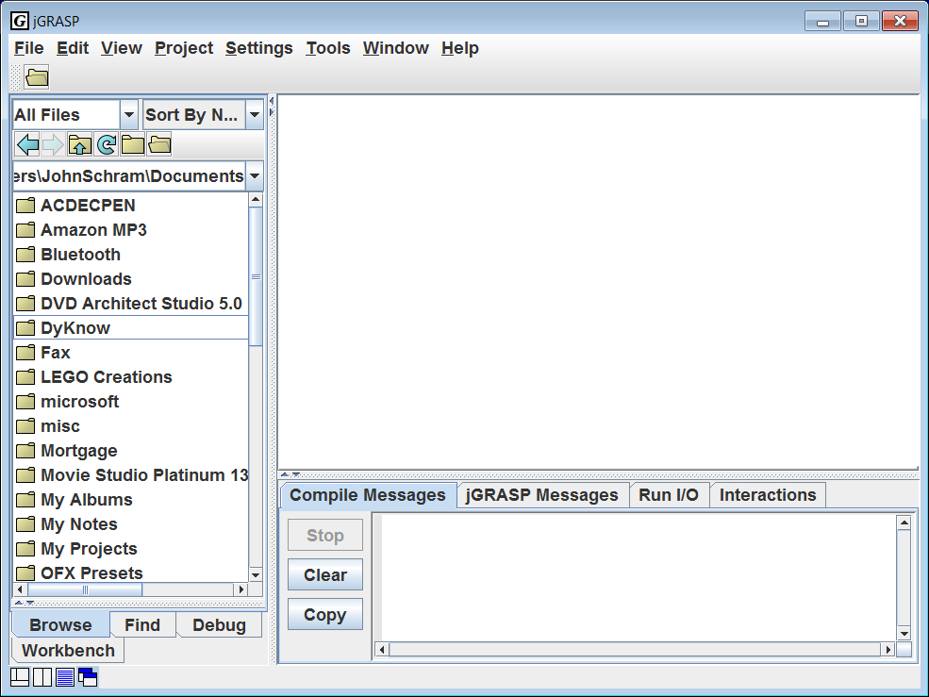

Slide 10
Edit Window
Browse
Window
Output/Message Window

Slide 11
Note: You can move the borders between the windows to change their sizes to suit your needs.

Slide 12
Organization of
Program Examples

Slide 13
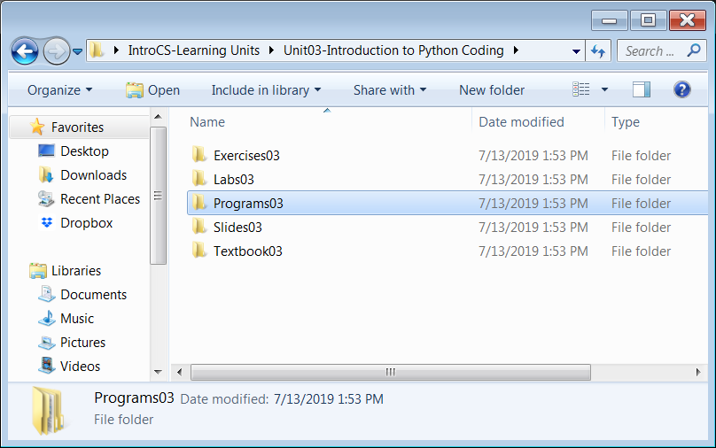
Organization of Program Examples in LearnIntroCS

Slide 14
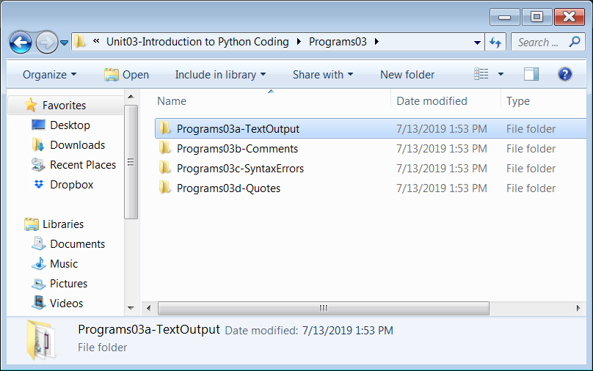
Organization of Program Examples in LearnIntroCS

Slide 15
Loading, Executing
& Editing Python
Files in jGRASP

Slide 16
Click the Open File icon.

Slide 17
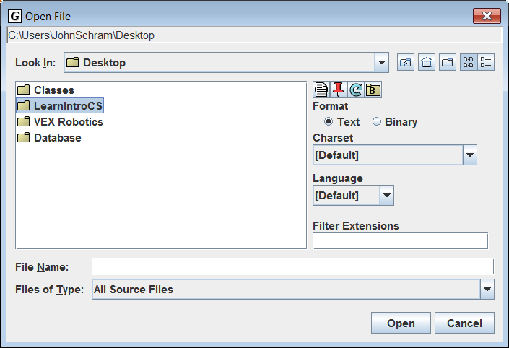
Browse to the Desktop
(or wherever your LearnIntroCS folder is stored) and double-click LearnIntroCS.

Slide 18
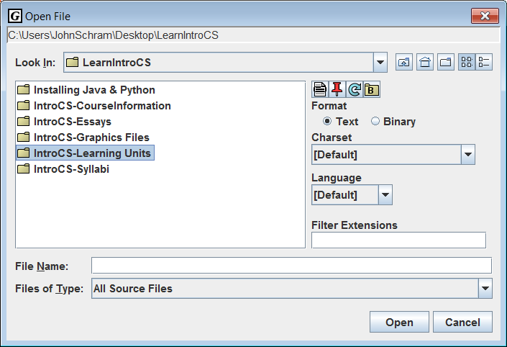
Double-click
IntroCS-Learning Units

Slide 19
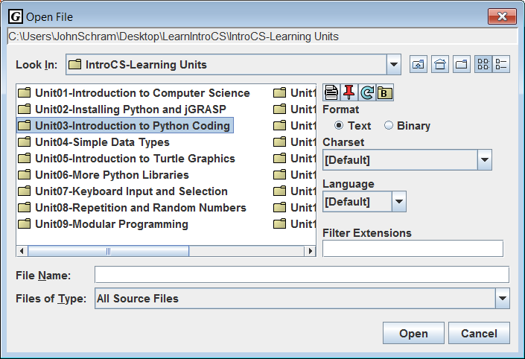
Double-click
Unit03-Introduction to Python Coding

Slide 20
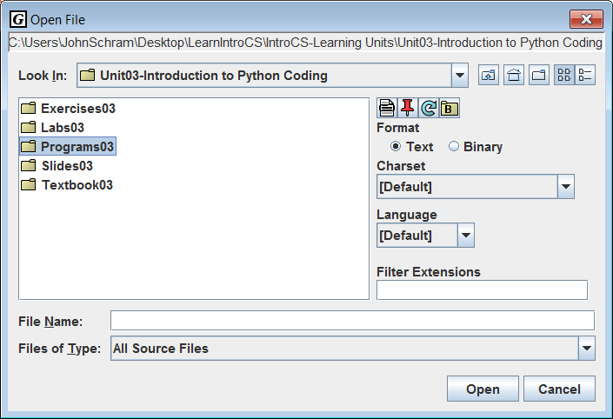
Double-click
Programs03.

Slide 21
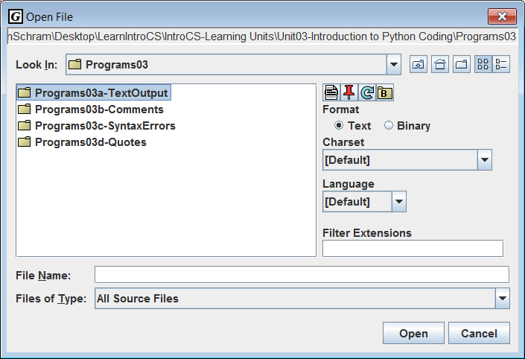
Double-click
Programs03a-TextOutput.

Slide 22
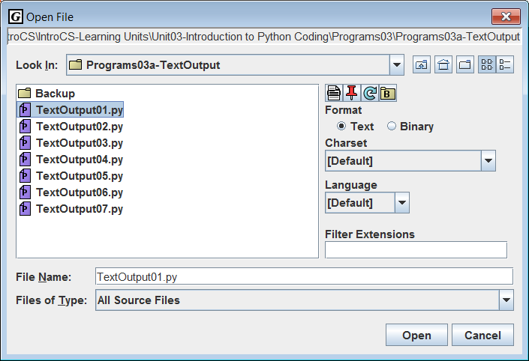
Double-click
TextOutput01.py

Slide 23
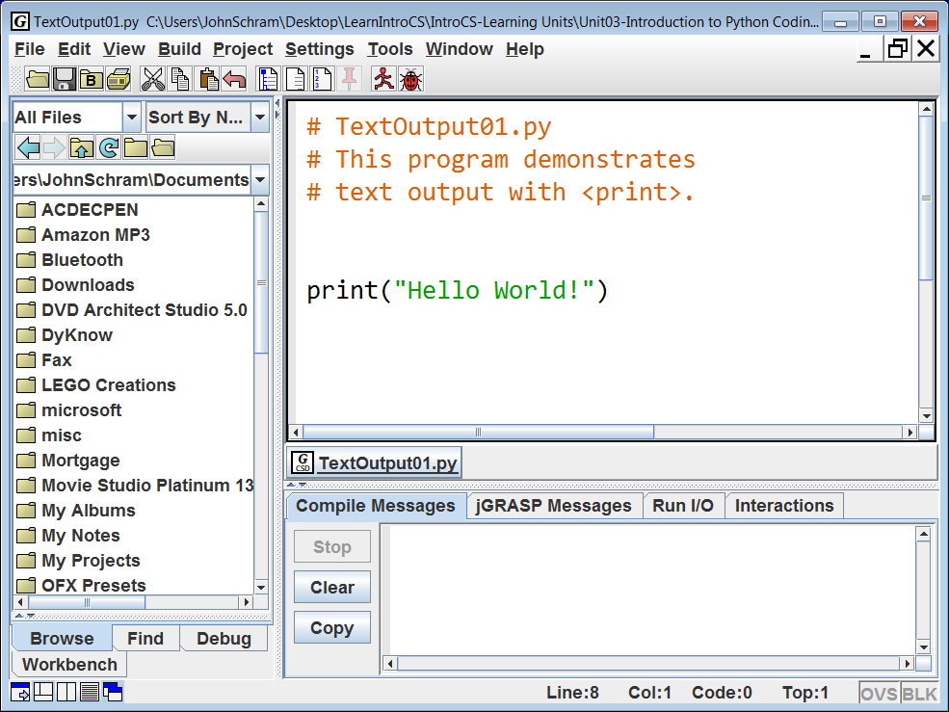
Right now the Browse Window does not match the location of the file in the Edit Window.

Slide 24
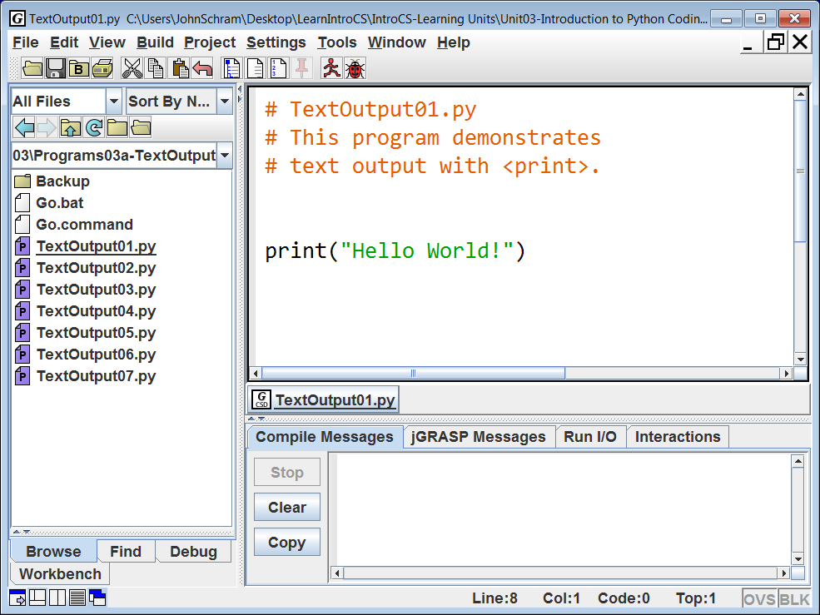
Click the icon of a folder with a “B” on it to fix this and to make loading other files from this folder simpler.

Slide 25
If you do not have line numbers, click this icon …

Slide 26
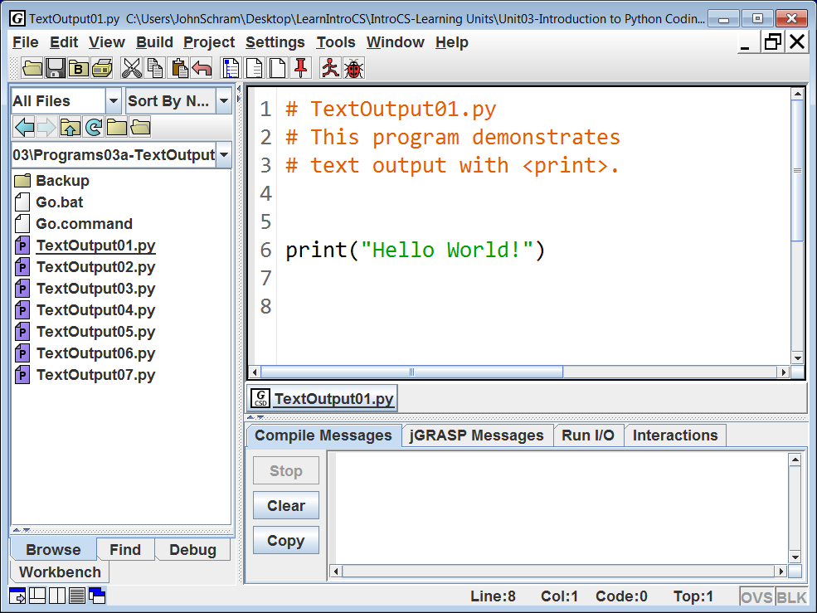
If you do not have line numbers, click this icon to turn them on. Line #s are useful for debugging.

Slide 27
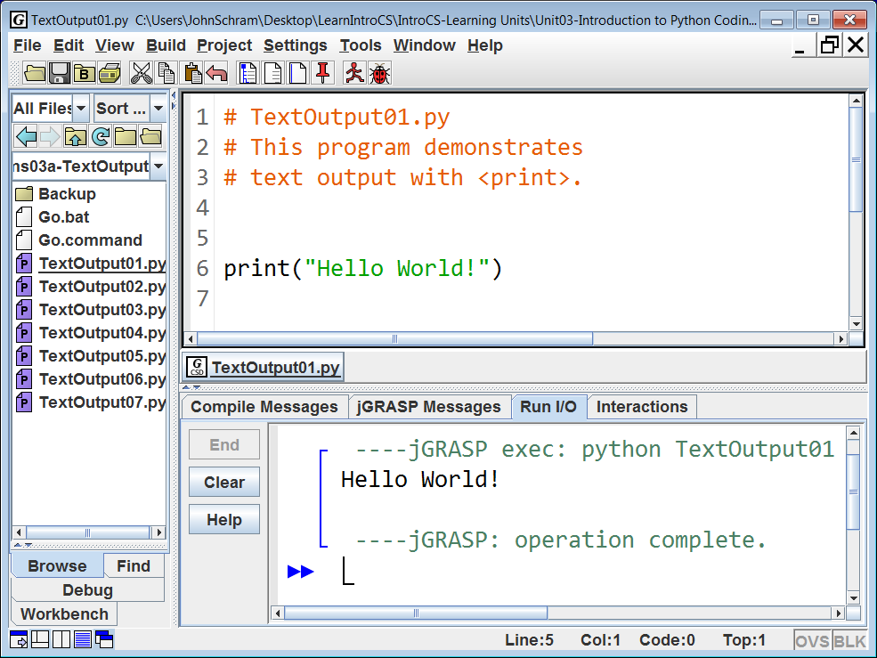
Click the icon of the Red Running Man to “execute” or “Run” your program.
The output is shown below:

Slide 28
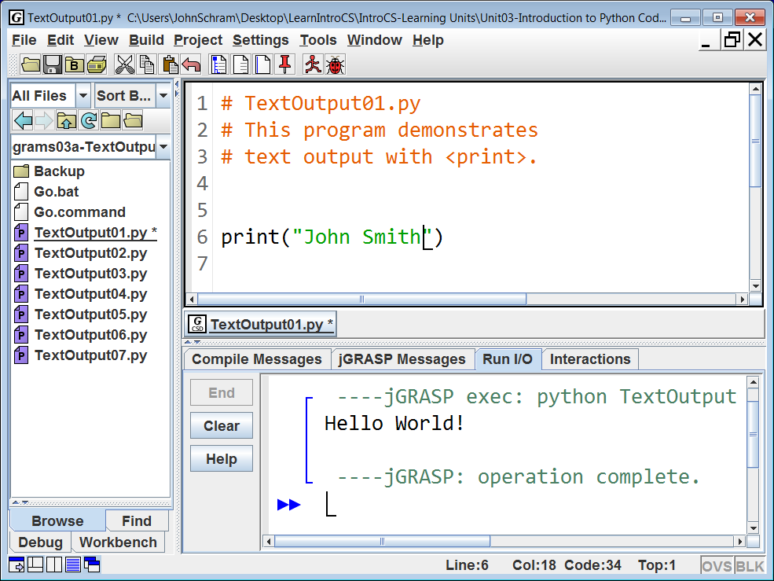
Change this program so that it will now display your name. Note the asterisks that show up by the file names. This means the changes you made have not been saved.

Slide 29

When you click the Save icon,
The asterisks (*) go away.

Slide 30
Note that even though we have changed and saved the program, we still see the old output.

Slide 31

Execute or “run” the program again to see the new output.

Slide 32
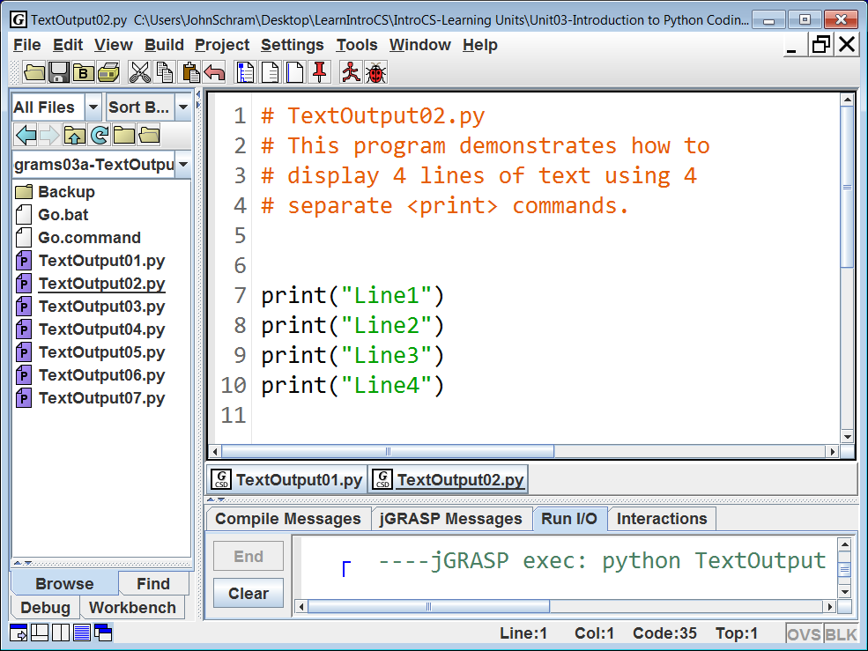
You can double-click any of these files to load them in the Edit Window…

Slide 33
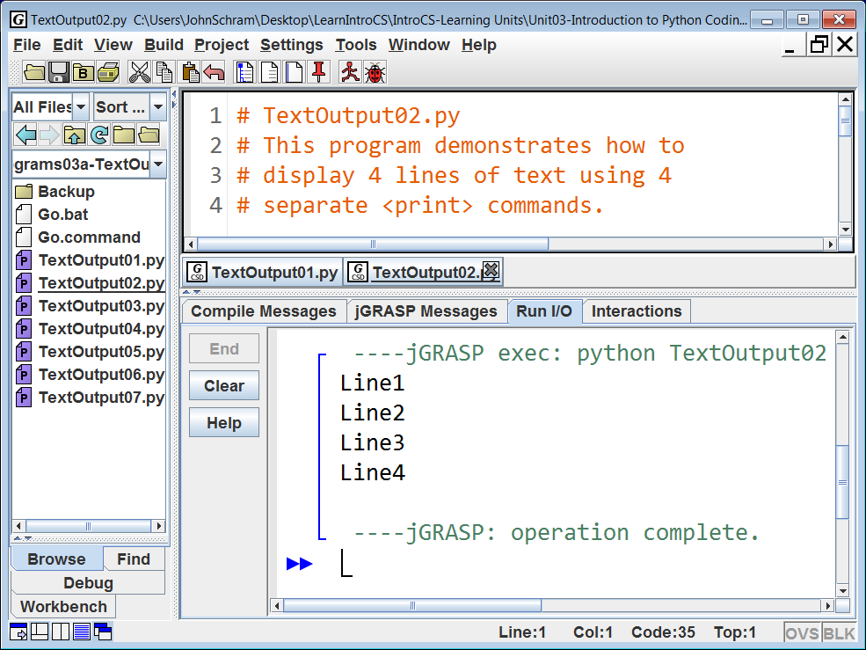
… and Run them as well.

Slide 34
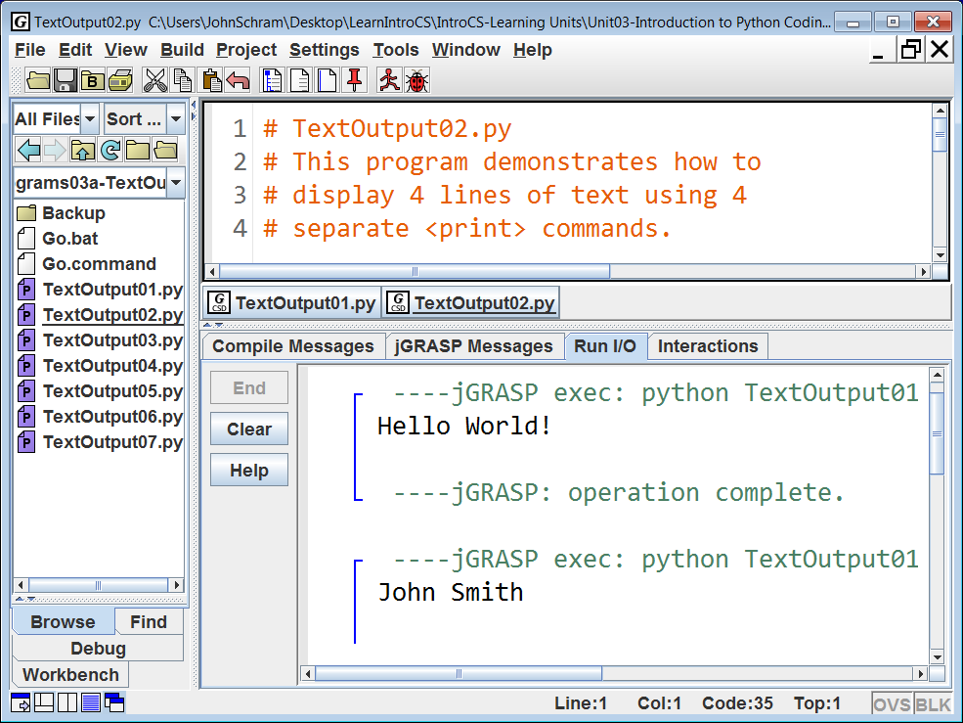
Try this: Scroll up in the Run I/O window. Note that all of the earlier outputs are still there.

Slide 35
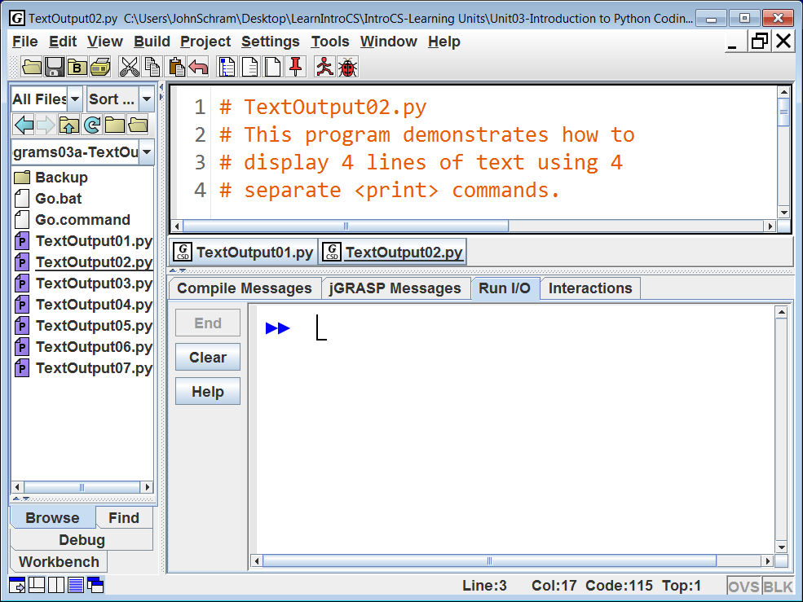
It is a good habit to Clear this window before you Run to prevent confusion between old and new outputs.

Slide 36
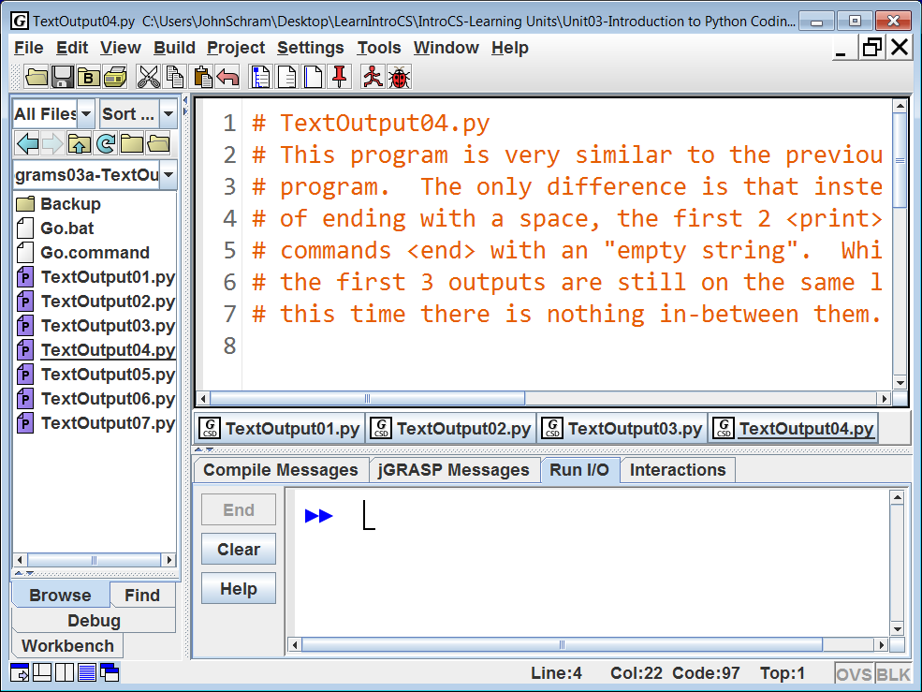
Note that multiple files can be loaded at the same time. Just click the any of the tabs below to work with a different file. This is useful for large projects.

Slide 37
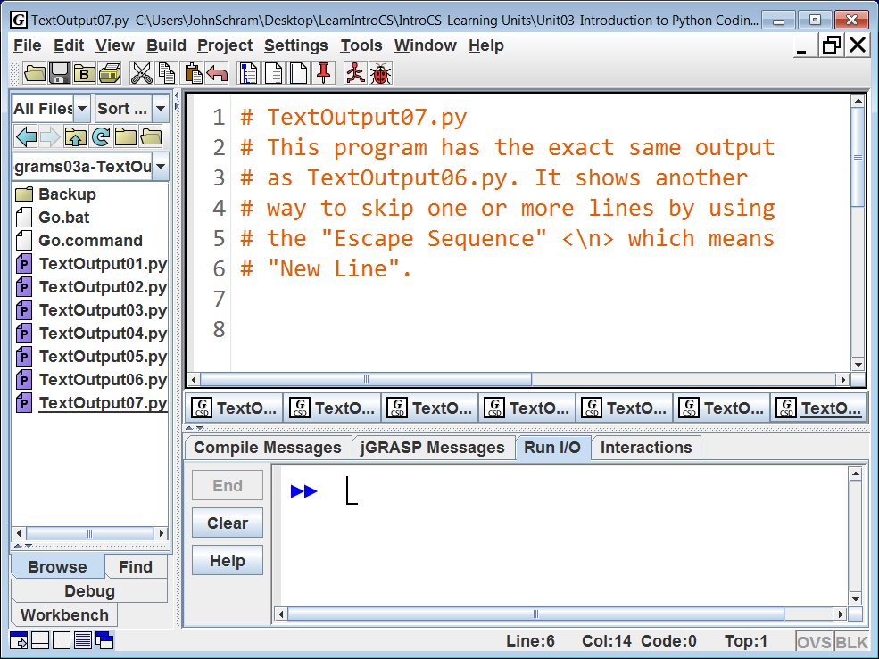
If you load too many files, you will no longer be able to read the file names on the tabs.

Slide 38
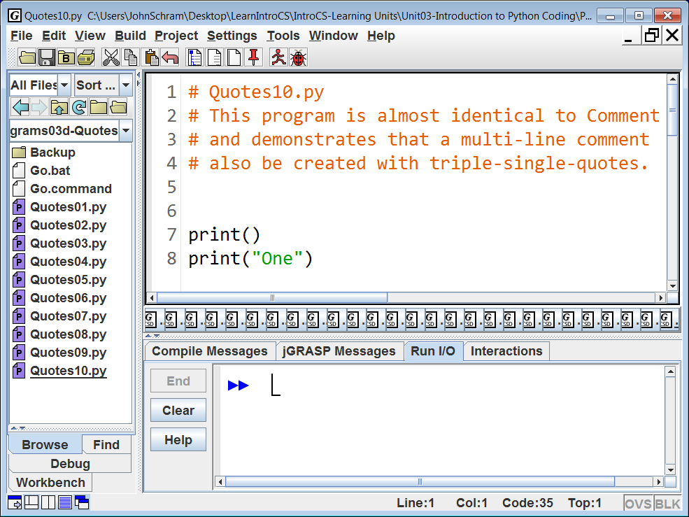
And since these files stay loaded, even if you quit and reload jGRASP, over time this issue can get worse and worse. However, there is a simple solution.

Slide 39
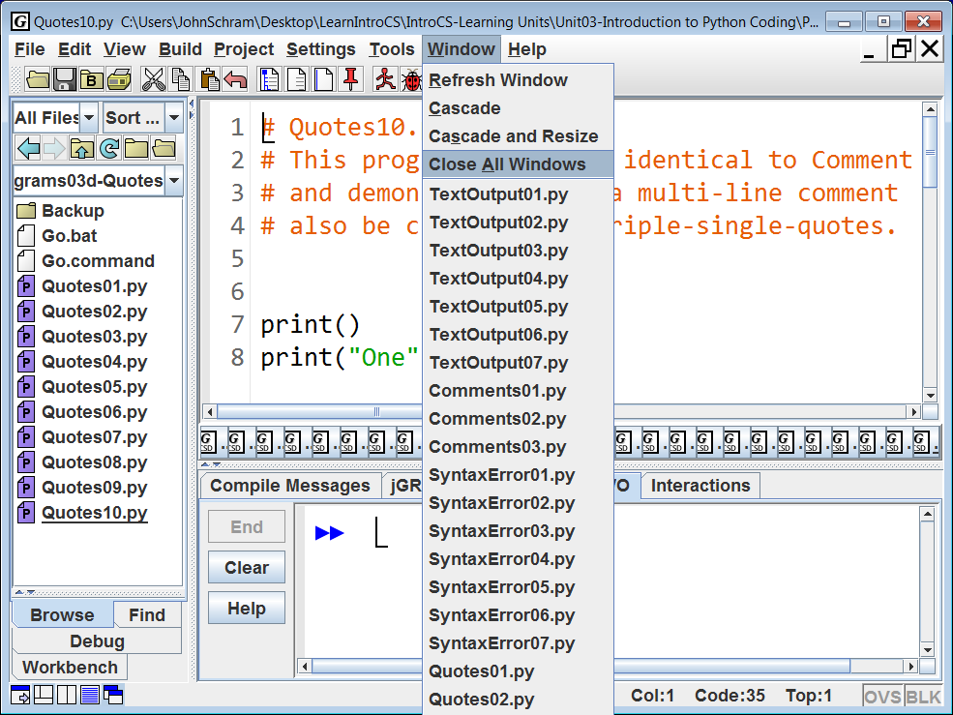
Another good habit is to occasionally go up to Window and select
Close All Windows. This is far less tedious than closing each and every single window individually.

Slide 40
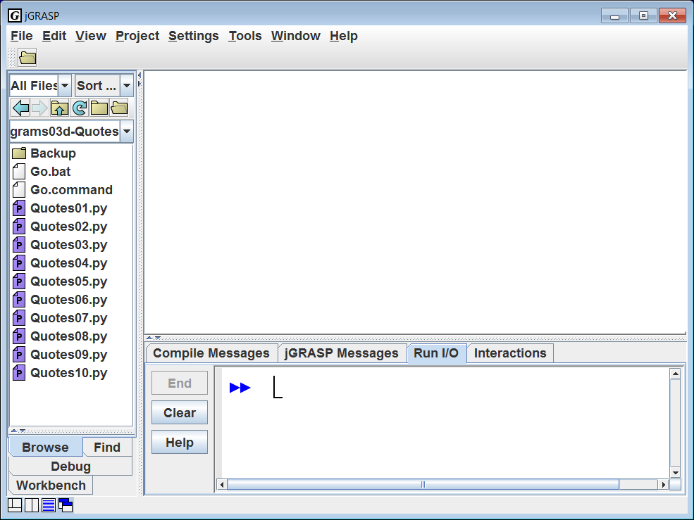
Another good habit is to occasionally go up to Window and select
Close All Windows. This is far less tedious than closing each and every single window individually.
And now you have a clean slate again.

Slide 41
Practice
You need to become proficient in not only loading jGRASP, but also loading and executing ANY of our LearnIntroCS program examples from jGRASP.
Do the following:
1. Quit jGRASP
2. Reload jGRASP
3. Load and execute each of the files listed below.
From Unit 4: MathOperators07.py & Shortcut06.py
From Unit 6: MathLibrary14.py & GraphicsLibrary22.py
From Unit 8: Repetition01.py & RandomGraphics03.py
From Unit 9: GraphicsProcedures04.py & Functions04.py
From Unit 13: Output1303.py & Lab13A.py
From Unit 14: Output1414.py & Lab14A.py
It should NOT take you more than 30 seconds to locate any file in the LearnIntroCS folder.

